Slide 1
AI For Good Building Vision Edge solution with Vision AI Dev kit with Custom Vision
Bala

Slide 2
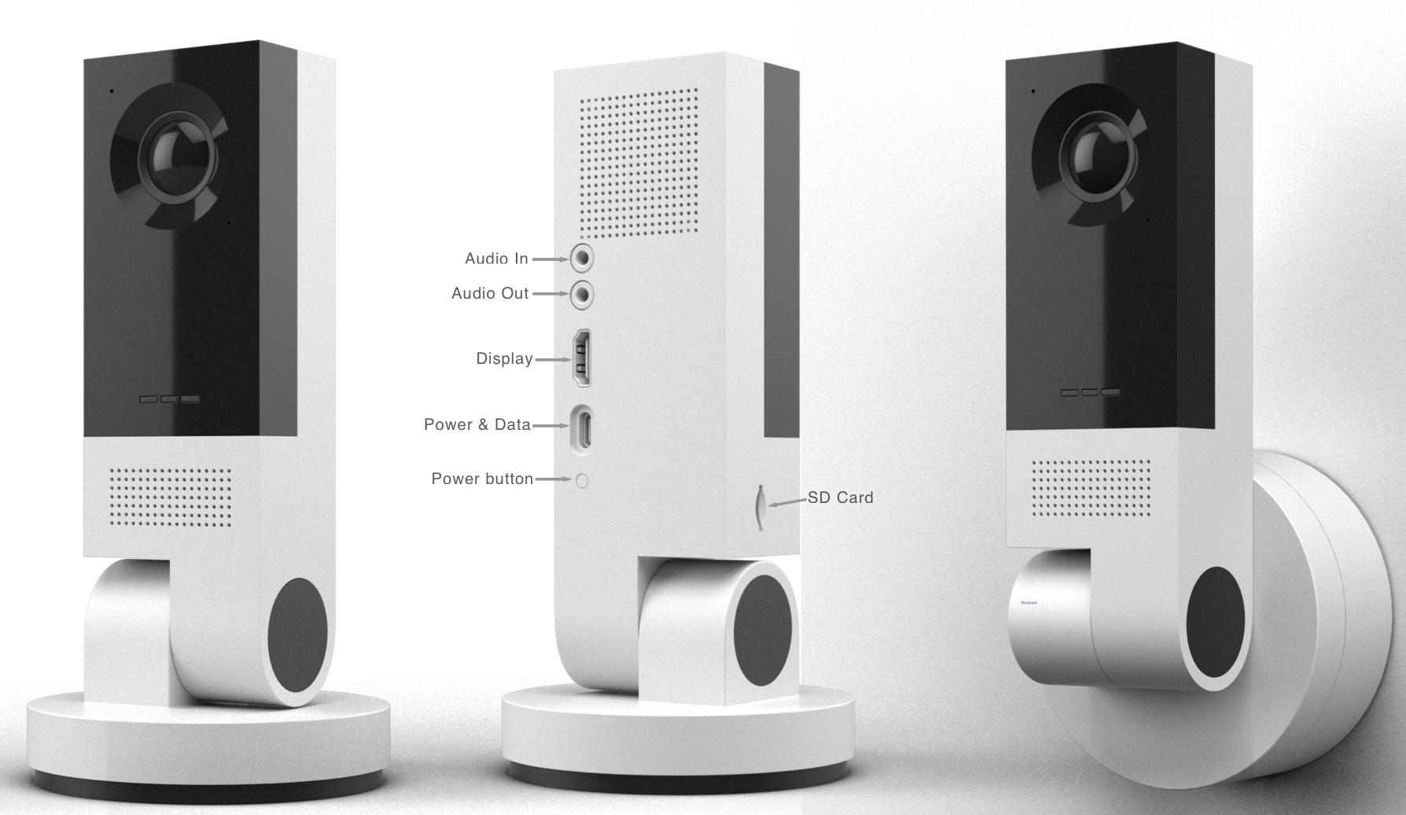
Why Vision AI Dev Kit?
High-speed and volume of Frame processing on edge, building machine learning models and IoT edge management are more essential than ever.
Vision AI Dev Kit
We need a way to run and demo trained models
Rasp Pi to run pretrained models on edge is very slow
Demonstrate Microsoft assets like Azure Machine Learning services, Azure IoT , Cognitive Services – Custom Vision
Build a community of Computer Vision Enthusiast that share and build on each other ideas . . . . . . .
Learn ML and AI build solution for ourselves and our partners that scales …

Slide 3
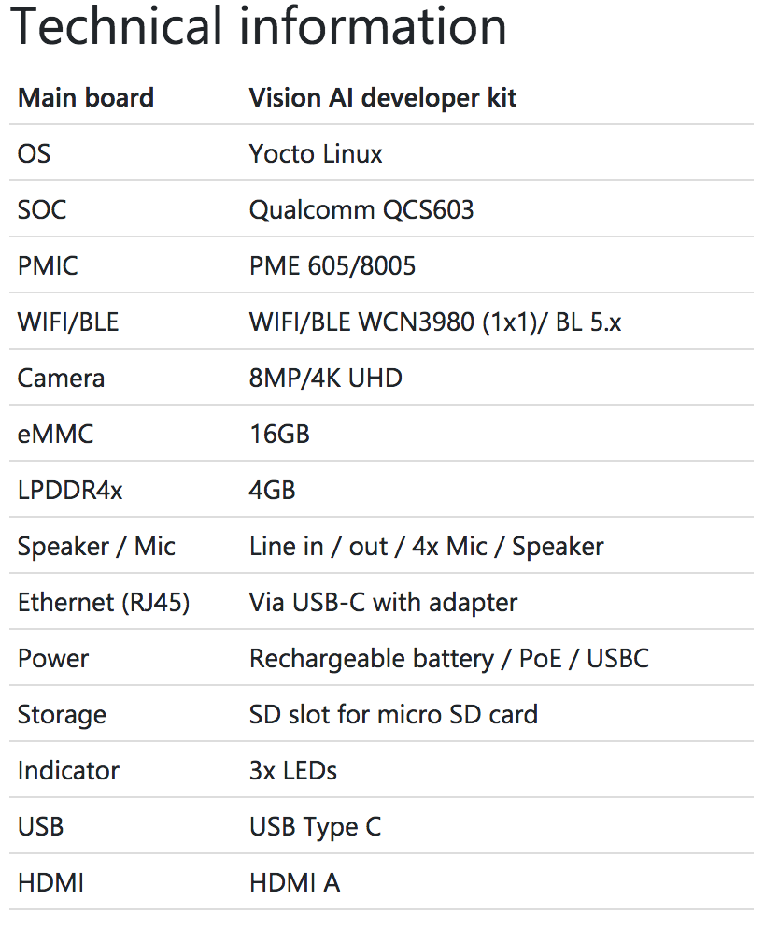
Vision AI Developer Kit Hardware Specification
Notes:
https://www.qualcomm.com/products/qcs603

Slide 4
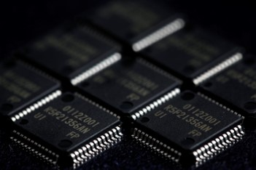
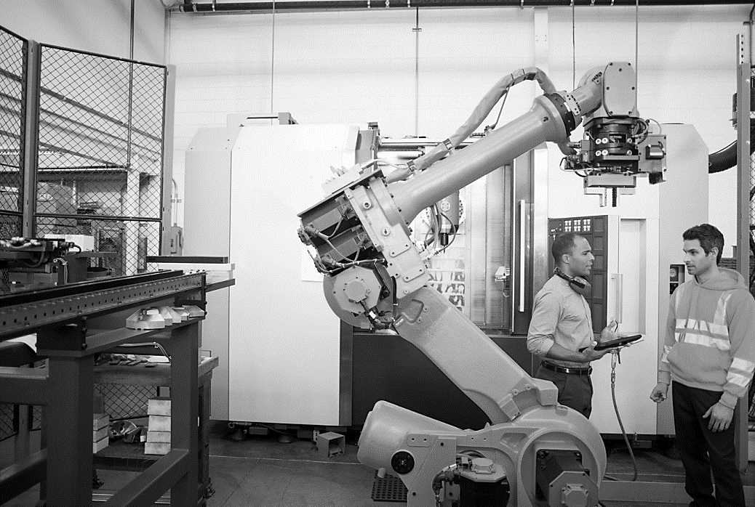
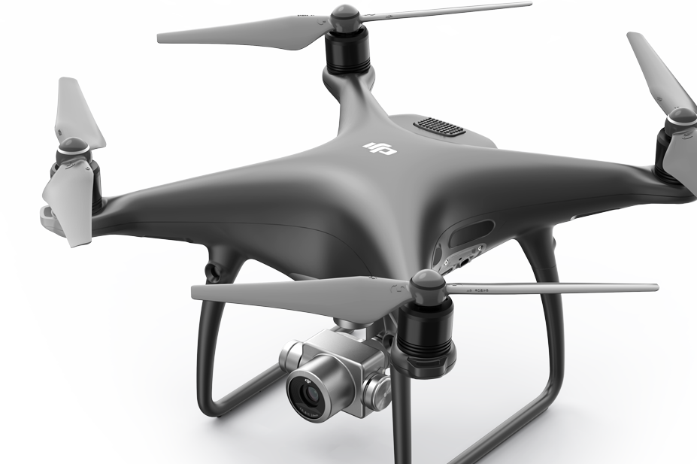
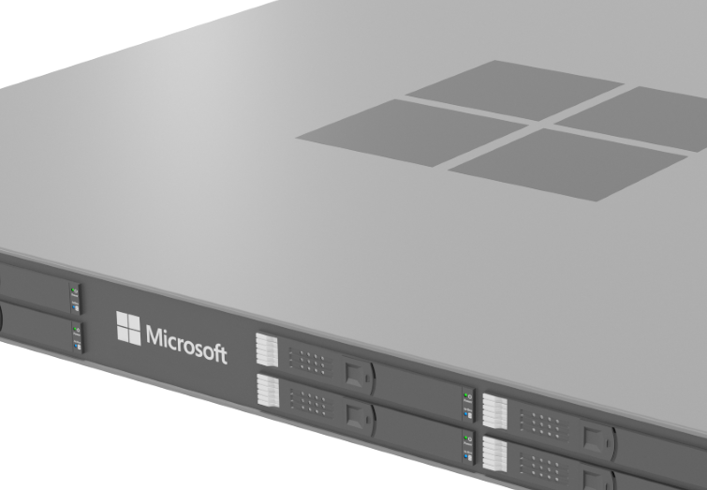
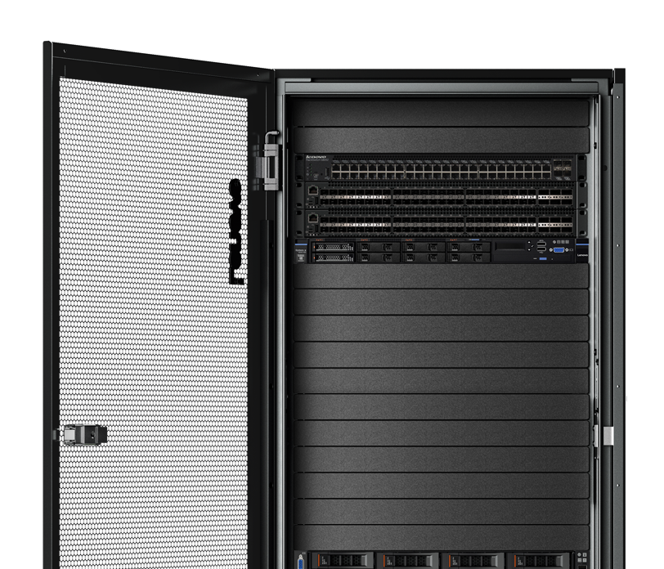
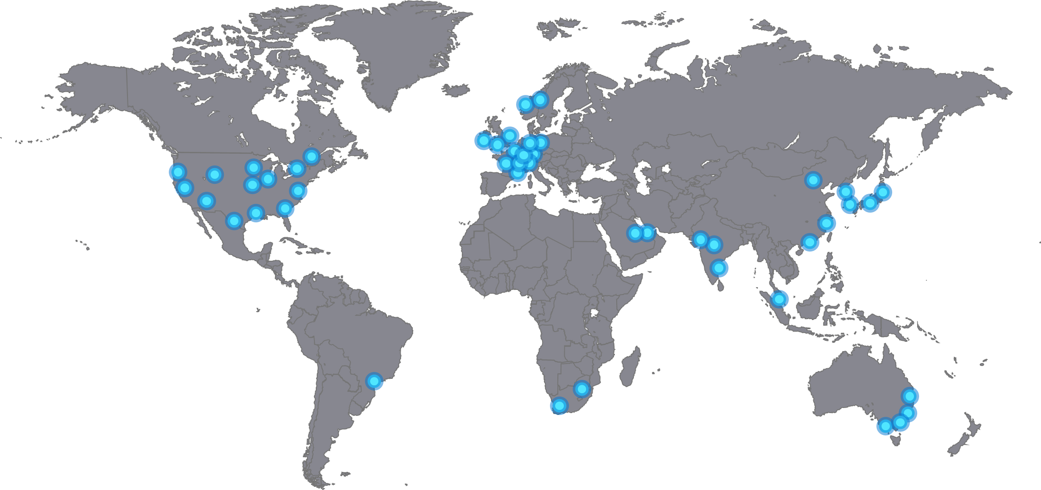
Azure Intelligent Edge + Cloud taxonomy
Sensors + control
Sensors to interactive
Integrated platform
Global scale processing
Microcontrollers Azure Sphere
Highly-secured, connected Azure Sphere MCU running our OS and services
3P Low-cost MCUs running FreeRTOS and our Azure Device Services
IoT devices Azure IoT Device SDK
Industry specific sensors and devices from partners
1000+ Azure IoT certified devices and growing
Edge devices Azure IoT Edge
Deploy and manage Azure services in containers on any IoT device
AI, AzureML, Azure Stream Analytics and more
RPi through Intel Xeon procs
Windows, WinSvr, Linux
Edge appliances Azure Data Box Edge
Data Box Edge: AI-Enabled, Storage and compute Azure Edge appliance
3P WinSvr or Linux plus IoT Edge
Edge cloud Azure Stack
Cloud Consistent Edge
Edge and Disconnected Scenarios
Regulatory Requirements
Cloud app model on-premises
Hyperscale cloud Azure Regions
Full Range Hyperscale Cloud Services
Tiered Service availability: Heroes > Hubs > Satellites
Open Source Based Services & Tools
Most specialization
Full spectrum of Cloud + Edge form factors
Fewest form factors
Fewest services
Intentional and appropriate Azure Service Availability
Most services
Microsoft Confidential
4
Notes:
IoT Edge:
DJI Phantom 4 Pro (image from IoT Design team)
AzureStack images:
Lenovo images:
https://microsoft-my.sharepoint.com/:f:/p/ppacent/EpXZf26ayDpAv7scJLdmPc0BnnByXGUGogvwZkyaHUesag?e=XdgBbv
HPE Images:
https://microsoft-my.sharepoint.com/:f:/p/ppacent/EjzZtmY-ShNCrLIQ4_xdvoUB6tsiaVgDZdFPemnD16ftLg?e=kVGQFD
Data Box
Images from Ignite 2018:
https://microsoft.sharepoint.com/teams/CloudintegratedStorage/GTM/SitePages/Home.aspx?RootFolder=%2Fteams%2FCloudintegratedStorage%2FGTM%2FShared%20Documents%2FSlide%20Library%2FImages&FolderCTID=0x012000689B76BCDCEC7446953A4A9D1593E1B0&View=%7B768D0745%2DE783%2D47E9%2D8425%2D9DCA9E29F8FD%7D

Slide 5
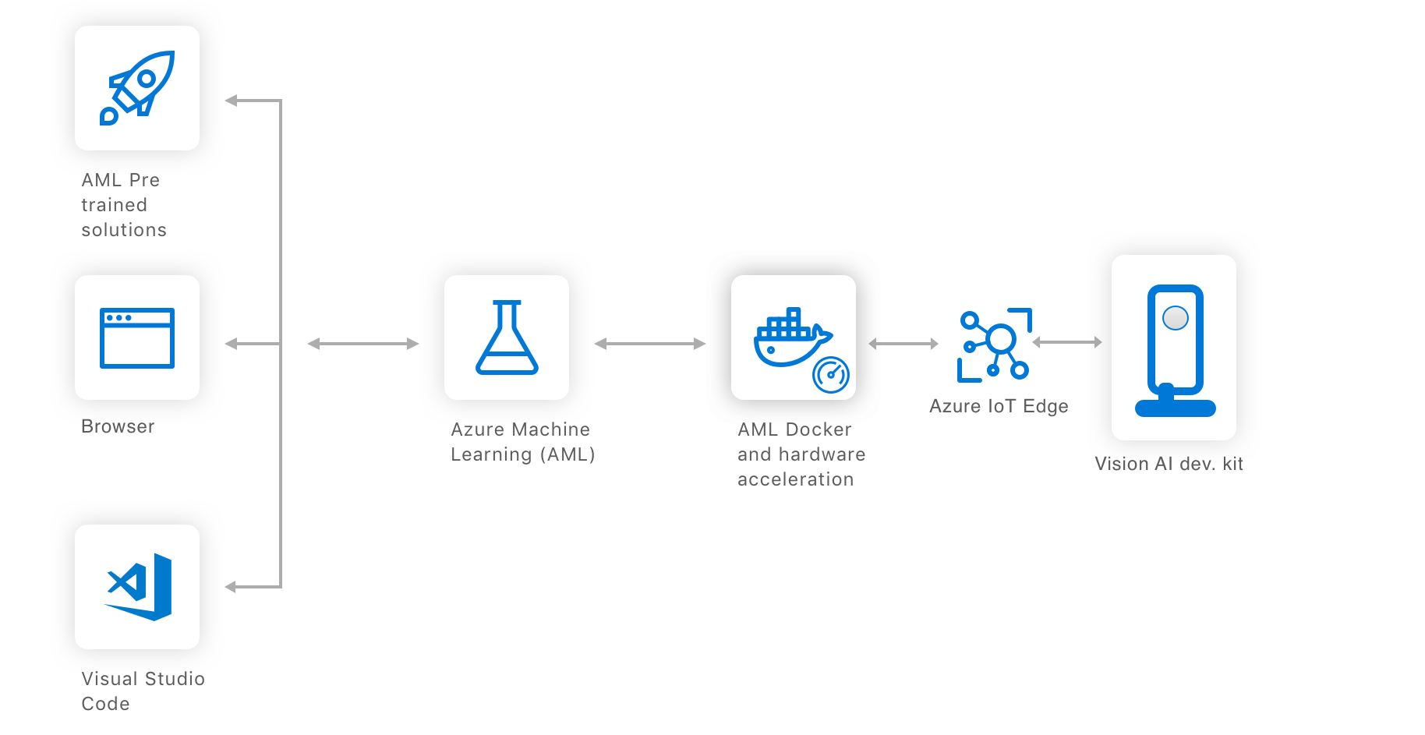
Vision AI Development kit – System Architecture

Slide 6
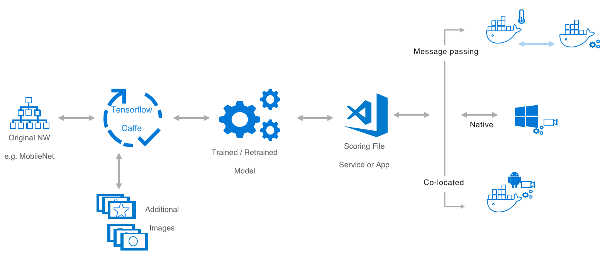
The components of a Vision AI application
Vision AI dev kit
Vision AI dev kit

Slide 7
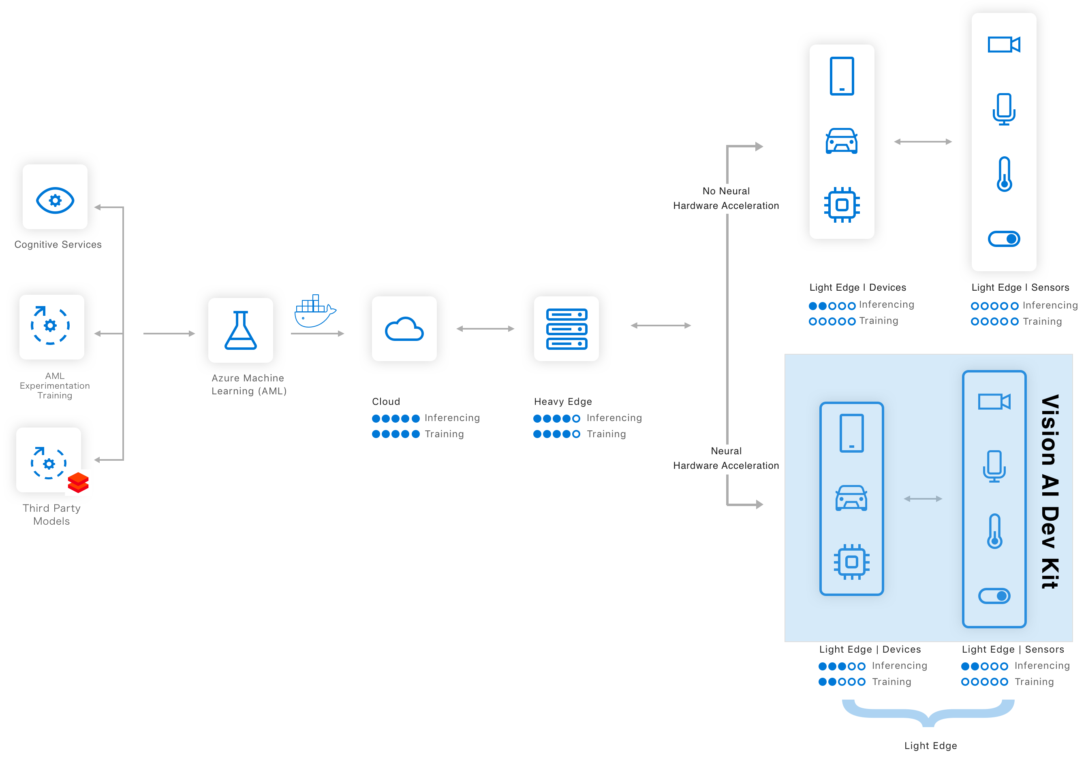

The Azure ML Deployment Pipeline

Slide 8
Ok Show me how I can use the kit?

Slide 9
AI For Good
How to apply vision AI for Health and Safety
Workplace safety use case for manufacturing/hospitals/construction/others
AI@edge

Slide 10
Why?
What if, you are hit with huge fine by government for a unintentional mistakes made by employee on missing some safety instructions.
How about launching program for employees following safety instructions wearing safety gear and brining Zero Incident plant.
Outcomes
Zero Incidents in plants
Avoid huge fines for unintentional mistakes

Slide 11
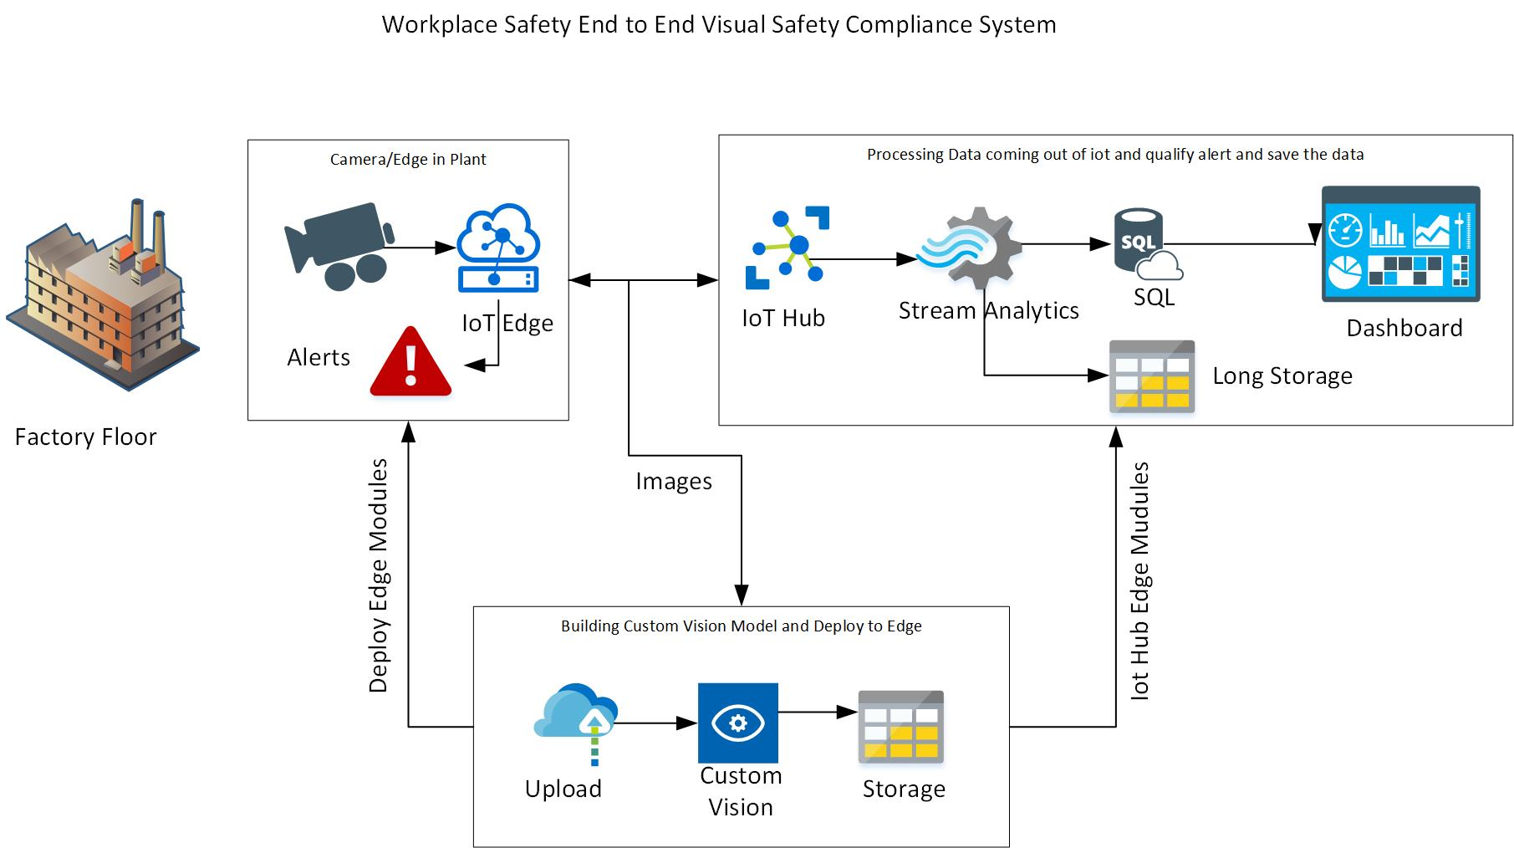

Slide 12
Vision AI Dev Kit Demo

Slide 13
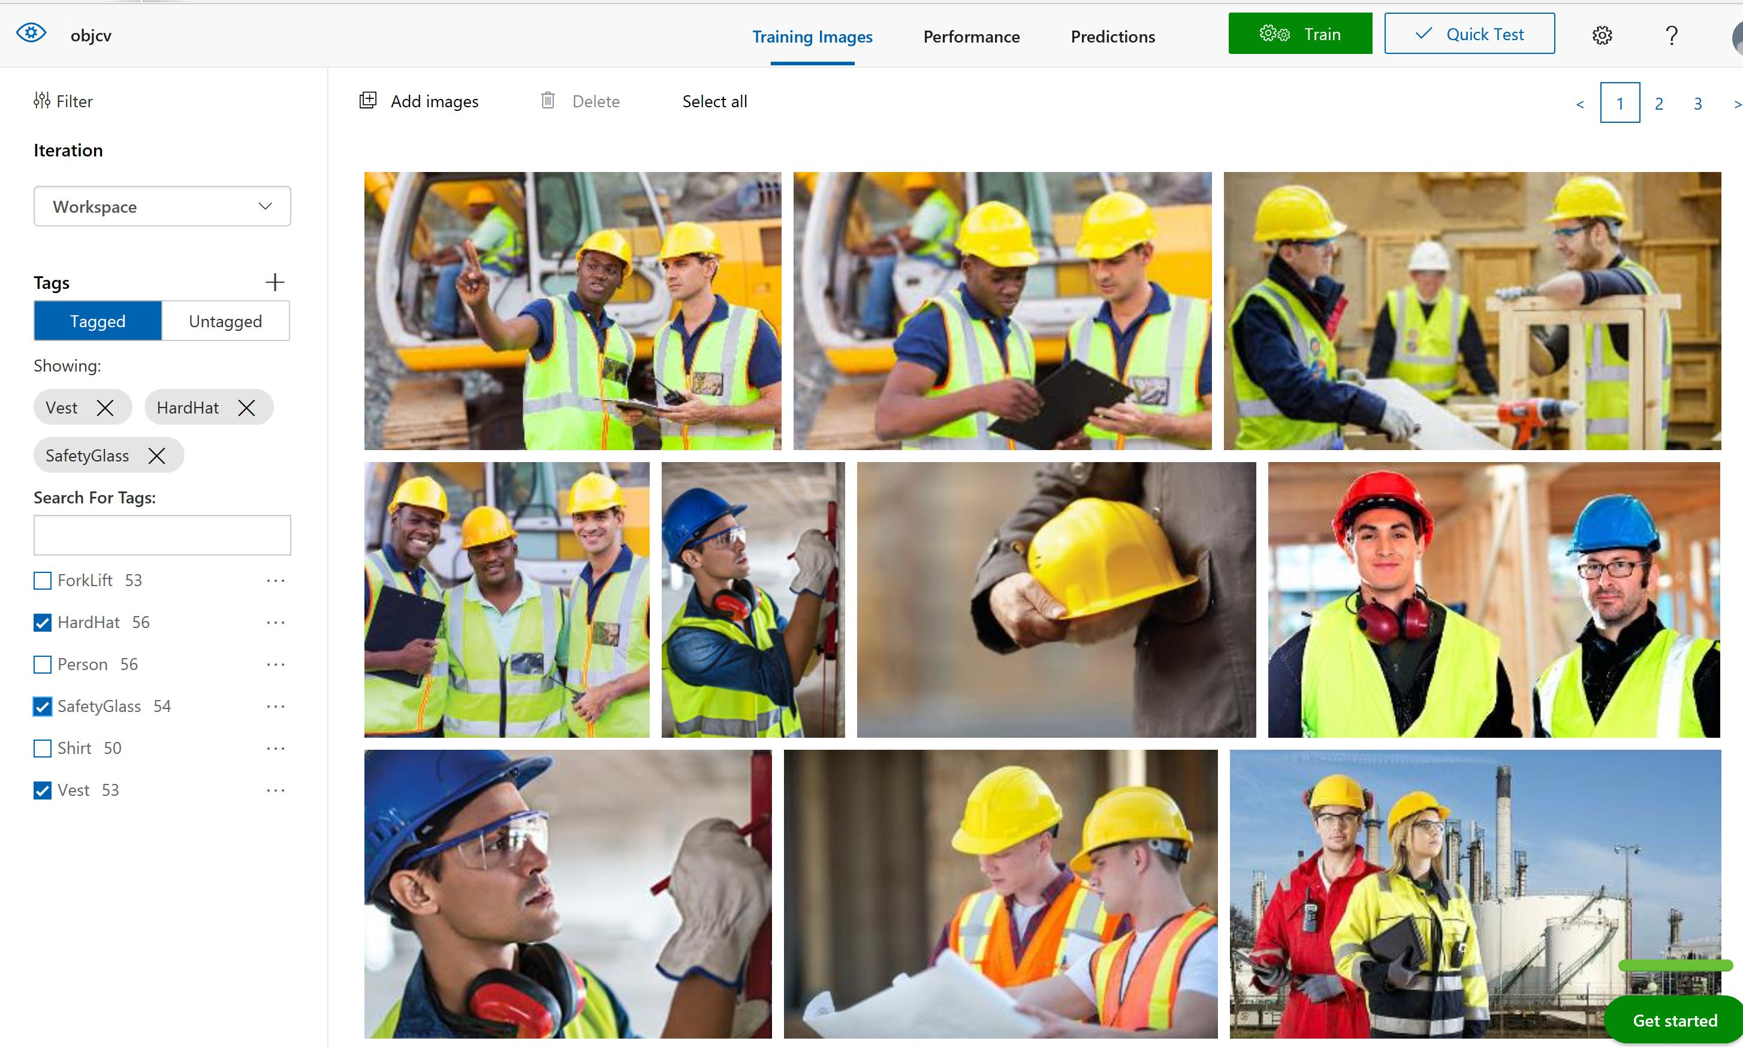
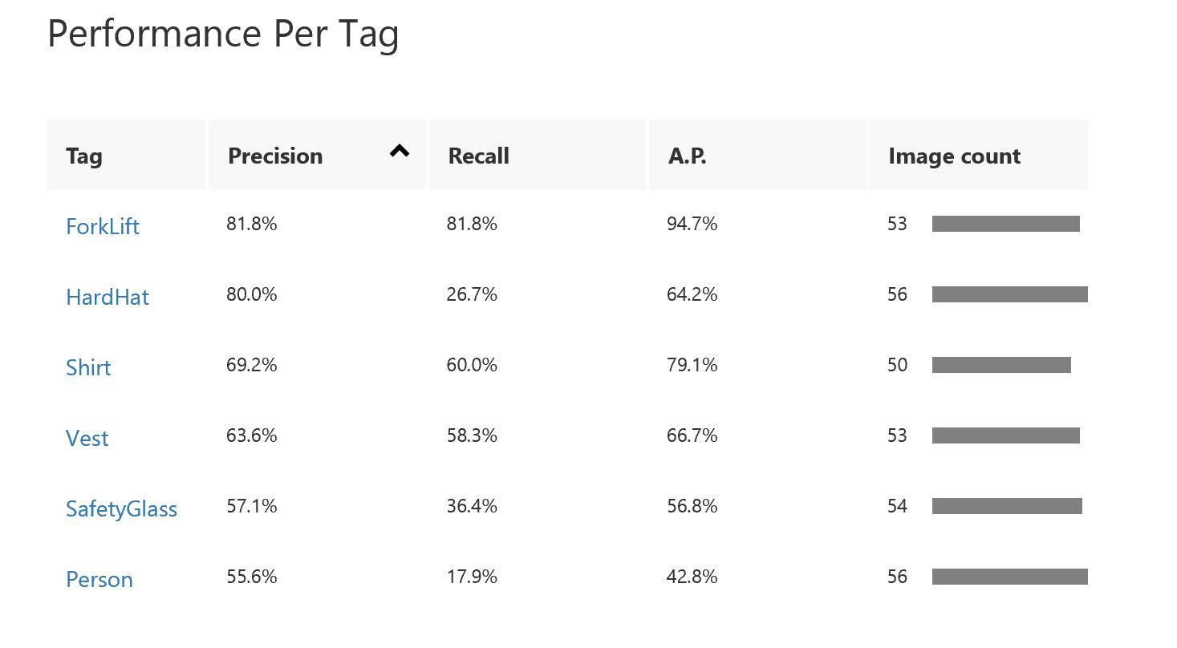
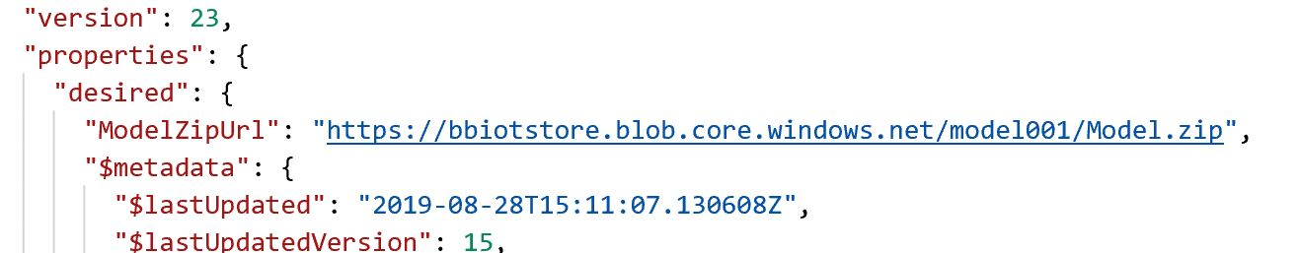
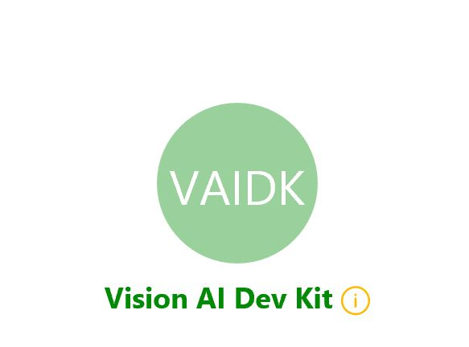
Custom Vision Model

Slide 14
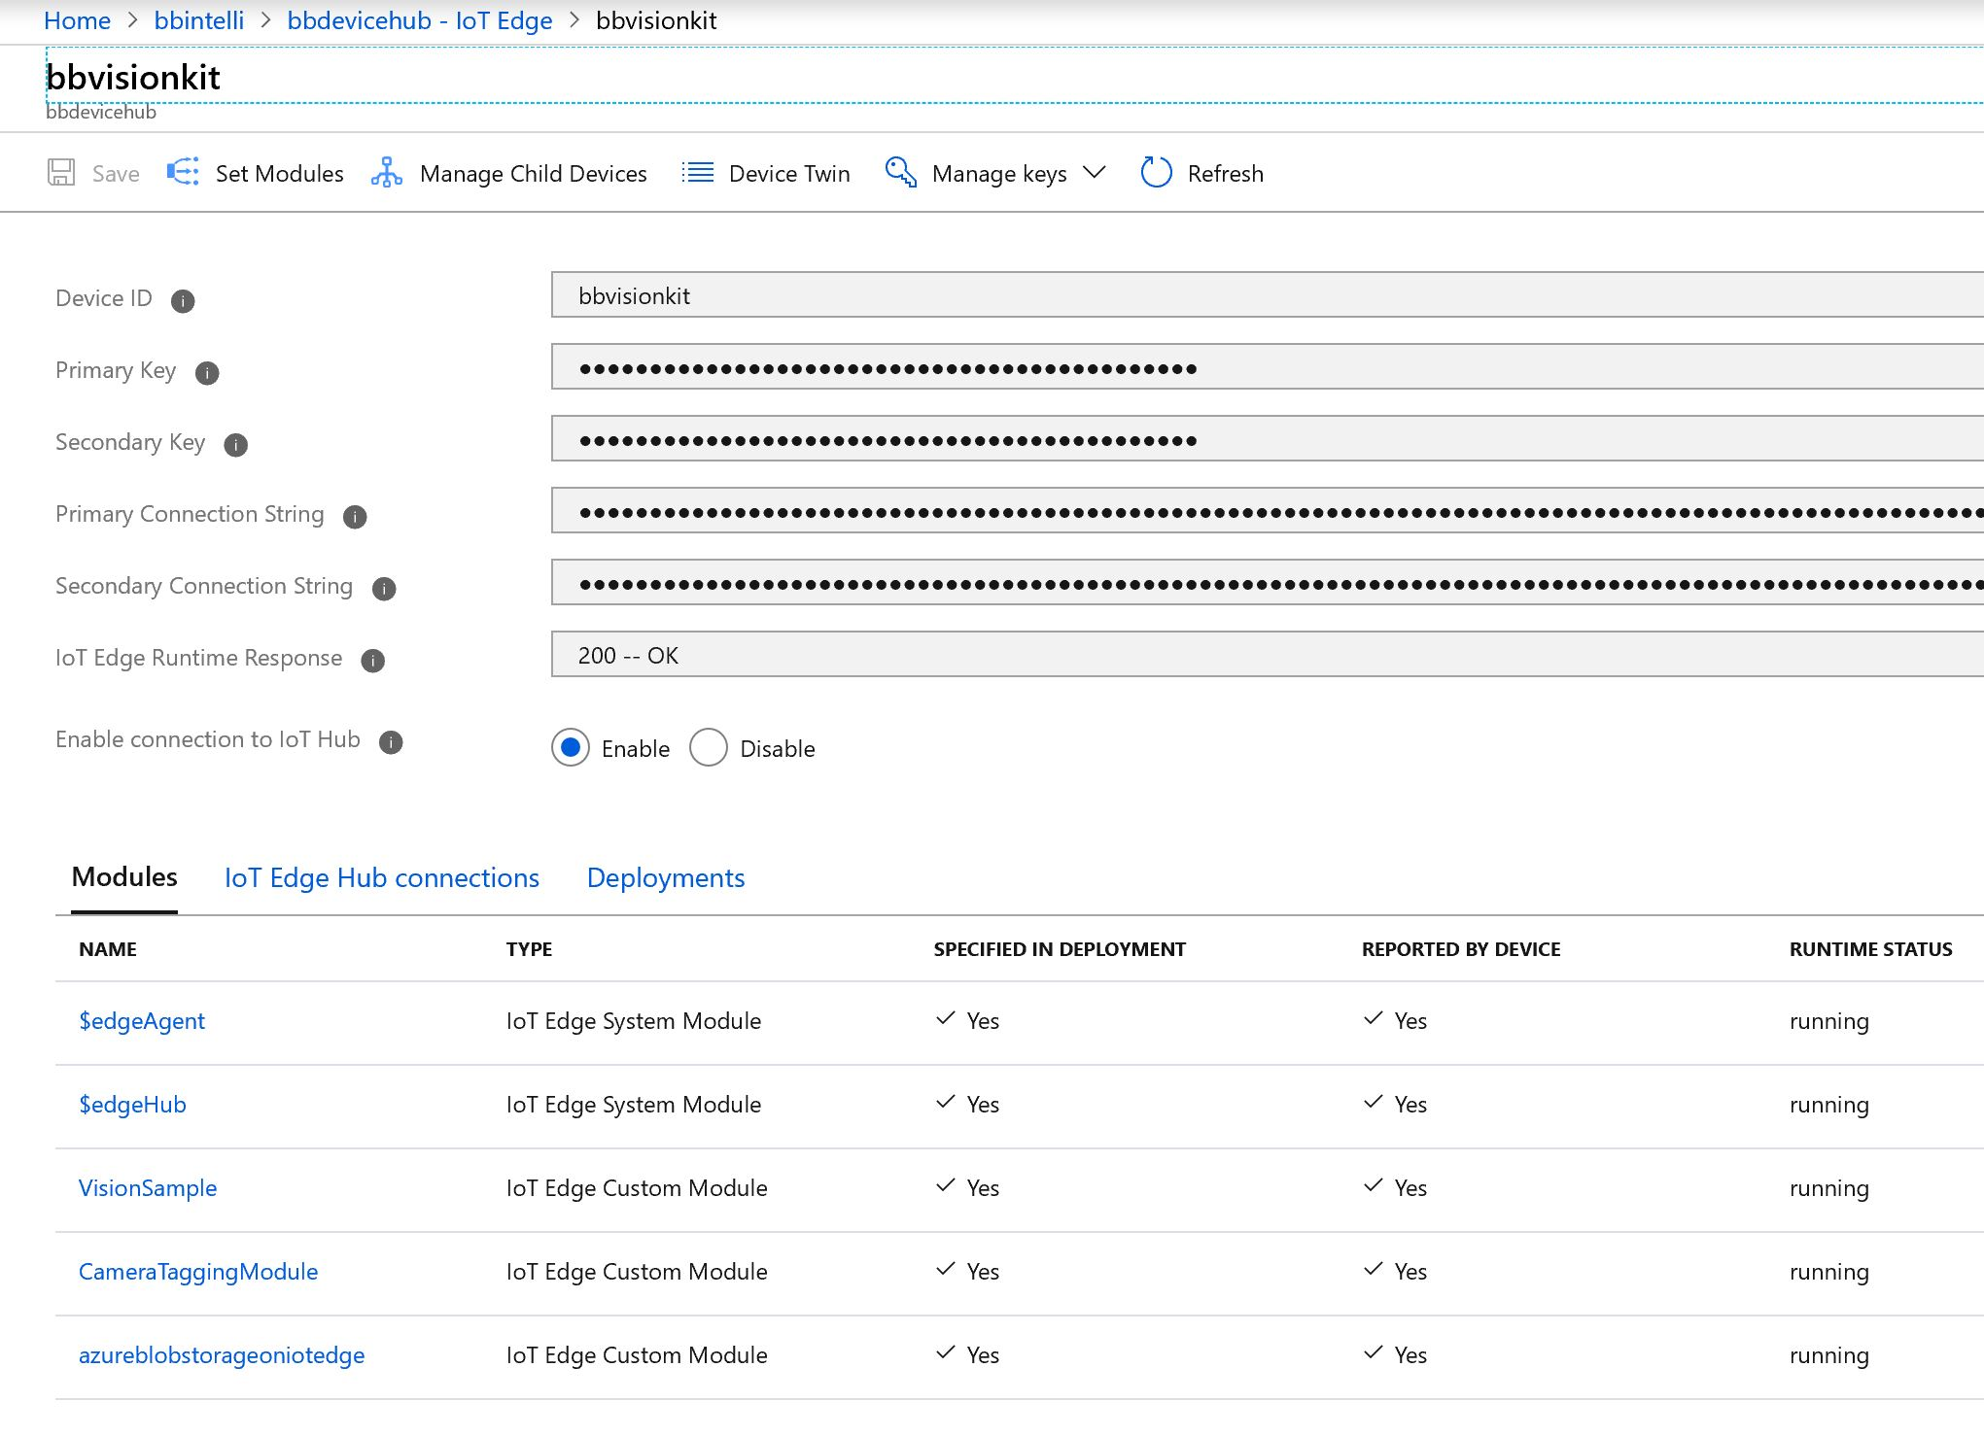
IoT Edge Modules Running in Vision AI Kit

Slide 15
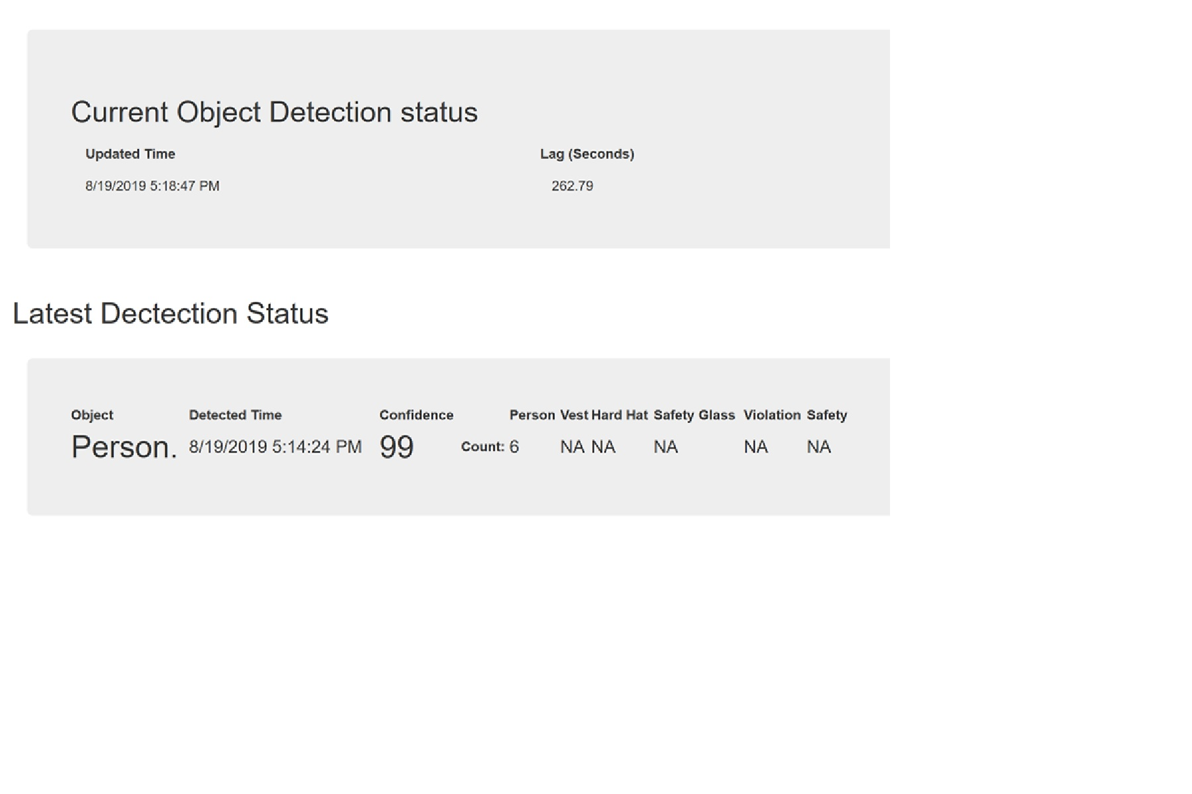
What Objects are detected?
The Top Box shows the latency between data received and processed.
The Second box shows the counts of objects detected and Violation count.

Slide 16
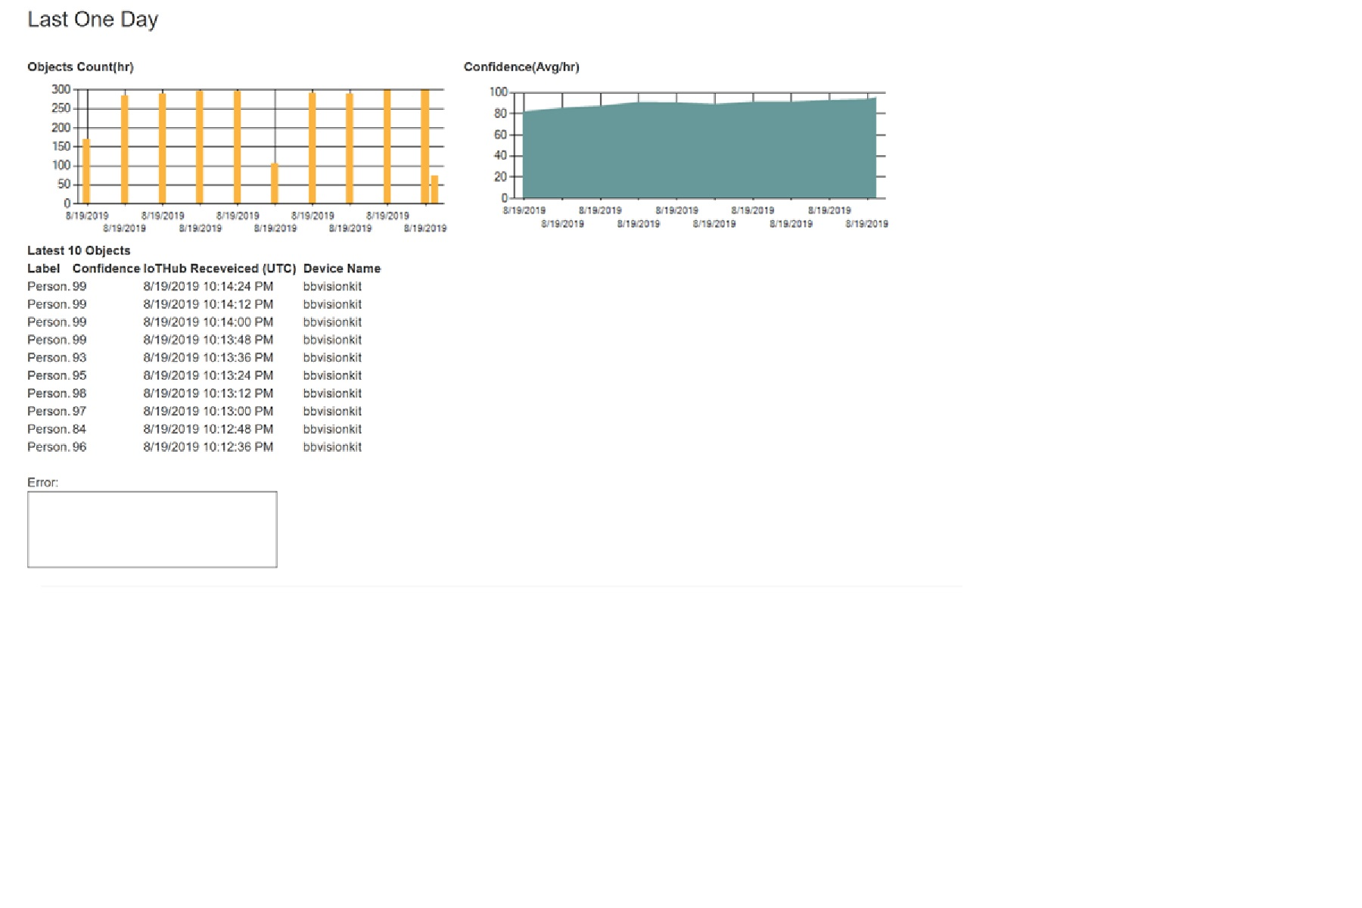
Watch Model Performance

Slide 17
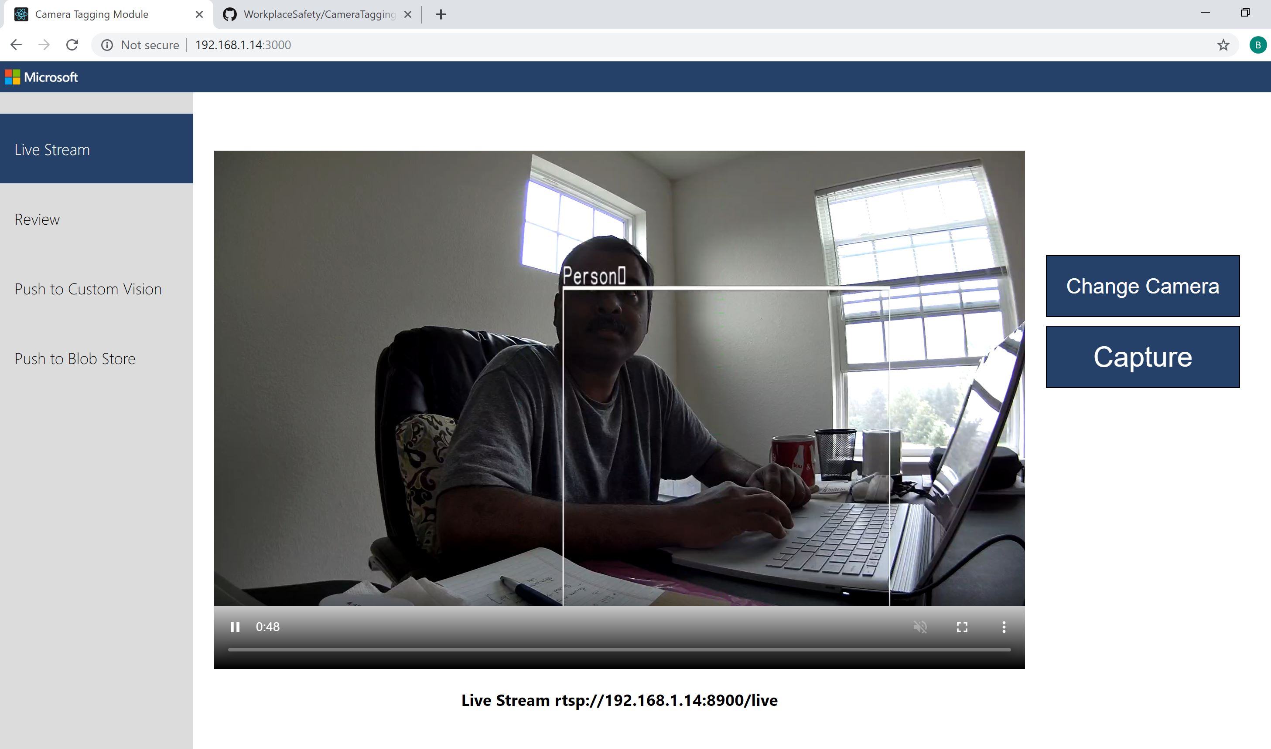
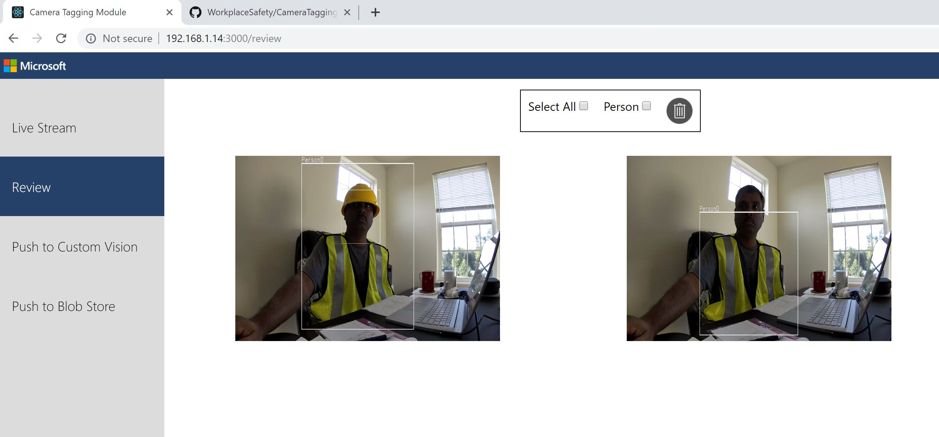
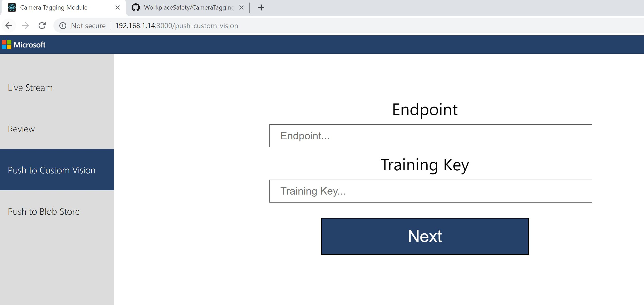
Camera Tagging Module

Slide 18
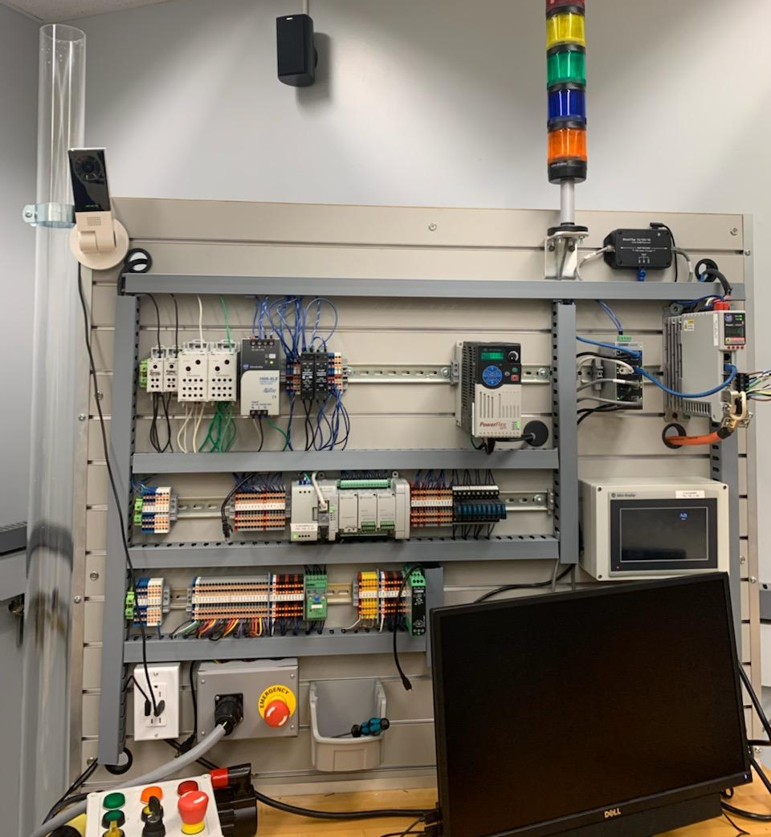
What’s Next
Purdue Engineering – Research on Safety Glass for MFG.
Rockwell Automation Deployment and Testing

Slide 19
Customers
Purdue Intelligent Industrial Lab
Ifiveo
JJ Keller
Rockwell Automation
Showcased in JCI Innovation Partner pavilion
Show cased in IoT in Action 2019 conference
Komatsu
Ashley Furniture
John Deere

Slide 20
Customer Interested
3M
Ardent Mills
Pella
Sleep Number
Target
Caterpillar
Walgreens
Exxon Mobile – Construction

Slide 21
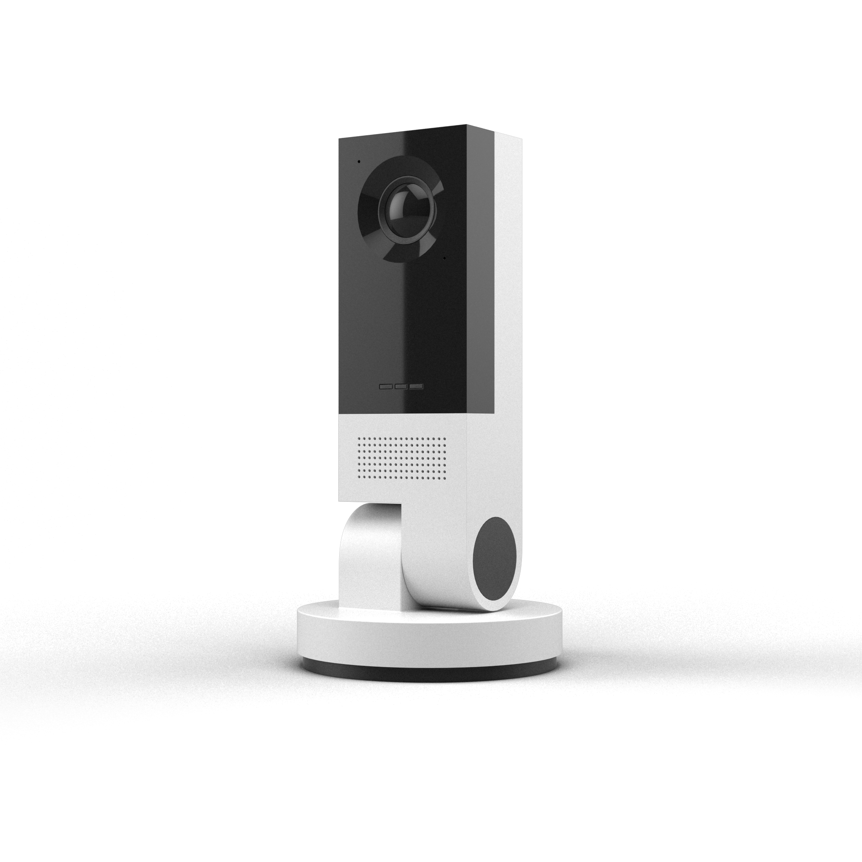
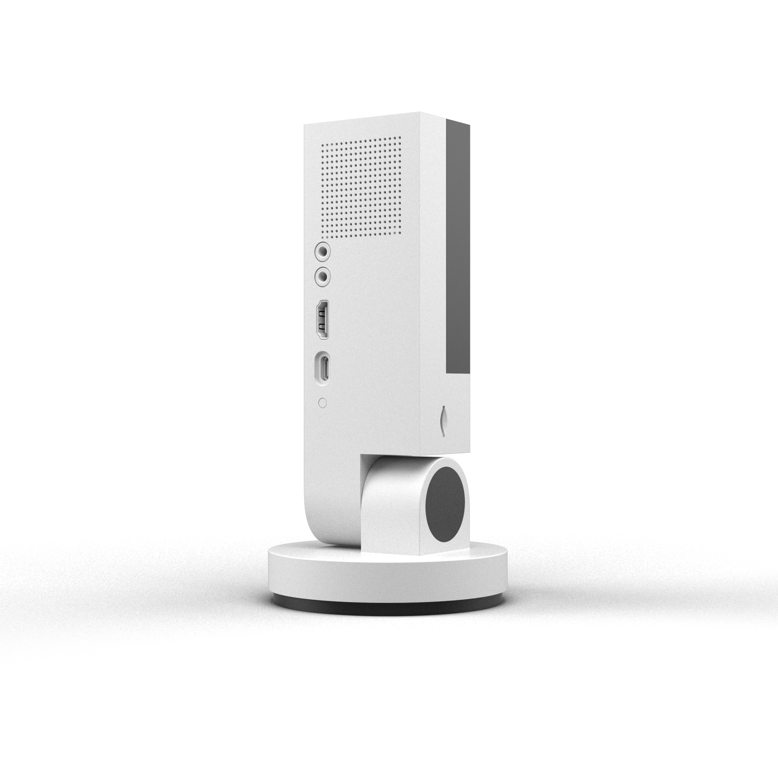
Vision AI Dev Kit A connected camera reference solution
https://visionaidevkit.com
Intelligent Cloud
Intelligent Edge

Slide 22
Questions ???

Slide 23
THANKS!!

Slide 24
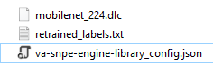
Ok you got a model now you need to understand how it works on ai camera…
Your trained model file converted to qualcomm dlc folder to run super fast
Your label file
What is this ???
Before we can explain this let`s understand how the camera really works

Slide 25
Ok you got a model then what ??
Your trained model file converted to qualcomm dlc folder to run super fast
Your label file
{
"Engine":0, //What is ur network 0 =mobilenet; 1= mobilenetSSD; 2= squeezenet
"NetworkIO":0, //ignore leave it as is
"ScaleWidth":224, //scale of your images
"ScaleHeight":224,
"PixelNorm":127.5,
"BlueMean":104,
"GreenMean":117,
"RedMean":123,
"TargetFPS":10, //speed of inferencing range from 1 -30 FPS(Frames per second)
"ConfThreshold":0.6, //accuracy threshold 0.6 means only send me results when confidence is above 60%
"DLC_NAME":"mobilenet_224.dlc", // your model file in same folder
"LABELS_NAME":"retrained_labels.txt", // your label file in same folder
"InputLayers":"input:0", // input layer to your model
"OutputLayers":["final_result"], // output layer from your model
"ResultLayers":["final_result:0"], // result from output layer
"Runtime":0 //where to run 0=CPU , 1 = DSP , 2 = GPU
}
Here you go ,..

Slide 26
Ai camera working
Iot edge module
IPC Client app
Camera
Ipc Webserver
REST API calls
CameraClient.connect(…) //Connect to camera
camera_client.toggle_preview(True) //turn camera on
camera_client.toggle_vam(True) //load model and start inferencing
camera_client.get_inferences() //get inference results

Slide 27
How the to iterate with models or va-config faster….

Slide 28
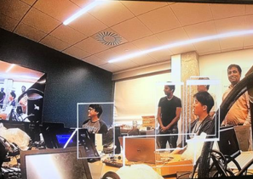
How Ipc Webserver work to get inferencing out
Iot edge module
IPC Client app
REST API calls
Camera
Ipc Webserver
QMMF
VAM
Camera sensor
HDMI
CameraClient.connect(…) //Connect to camera
camera_client.toggle_preview(True) //turn camera on
camera_client.toggle_vam(True) //load model and start inferencing
Read va-config file
Load model
- Start VAM Engine
- Overlay frames
- Send inference results back
camera_client.get_inferences() //get inference results
Notes:
https://teams.microsoft.com/_#/pdf/viewer/customspo/https%3A~2F~2Fmicrosoft.sharepoint.com~2Fteams~2FAzureMLbasedAICamera-Qualcomm~2FShared%20Documents~2FFrom%20Qualcomm~2FQualcomm_connected_camera_linux_multimedia_software_architecture.pdf?threadId=19%3Acfe37a3adb81457b918495563785d54c%40thread.skype&baseUrl=https%3A~2F~2Fmicrosoft.sharepoint.com~2Fteams~2FAzureMLbasedAICamera-Qualcomm&fileId=16F16D69-BA20-4C6D-BC07-451E429BCC45&ctx=custom-spo&viewerAction=view

Slide 29
Prerequisite please watch this video https://msit.microsoftstream.com/video/d8f5d281-05a8-4238-b452-dc339c378da2?list=studio

Slide 30
SW Architecture on actual device
AI IoT Container
Setup/Teardown BizLogic
Result BizLogic
IoT Hub
Model Config
Model DLC
Channel RTSP Stream
IoT Agent
Qualcomm IPC-API SDK
OS Image (Firmware)
IoT EdgeD
Qualcomm IPC-API Layer
Track control
Config, Model DLC
QMMF (track mgmt., overlay)
Inference Results
Frames
VAM
Configurable VAM Engines
Model DLC,label,va-config
prepare input
inference
format result
QMMF Inf. SDK *
Raw Frames
H.264 Track
Display Track
User code
SNPE/FastCV
Qualcomm
Azure IOT (MSFT)
Media Devices (camera..)
Network
Display (HDMI)
Inferencing Hardware
Azure ML (MSFT)
Altek
* NEW: a QMMF inferencing SDK
needed QCOM to maintain and publish for developers

Slide 31
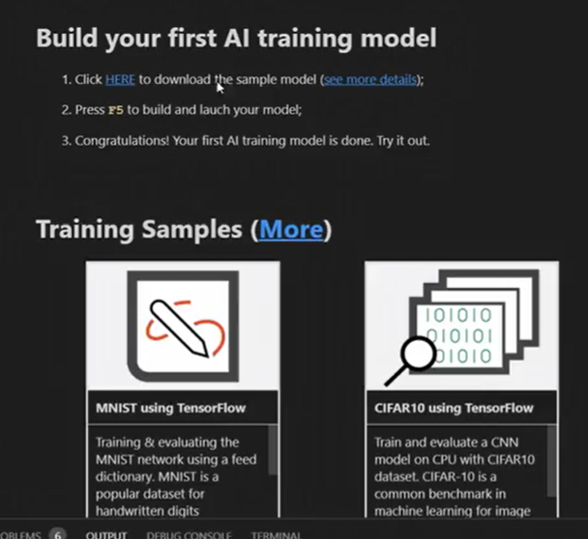

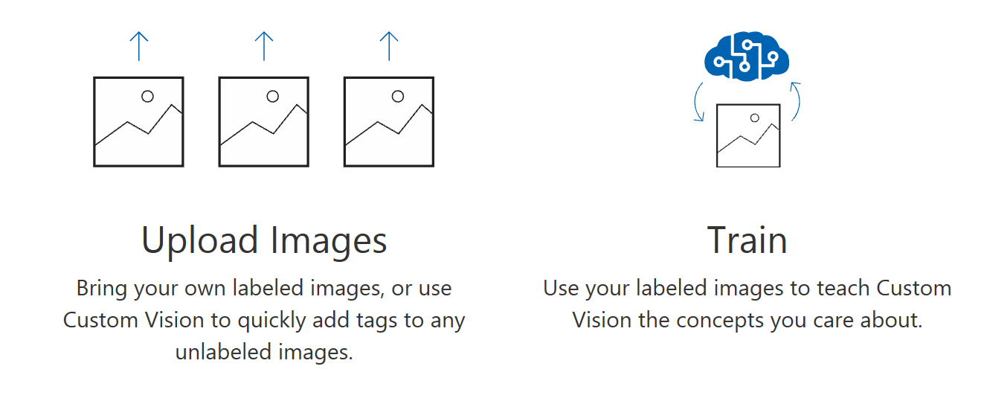

Getting started with Vision AI Dev Kit
Tools For AI in VS Code
https://www.customvision.ai/
Vision AI dev kit

Slide 32
Build your first Vision AI Dev Kit solution using 3 steps
1. Bring your images 2. Retrain using transfer learning
3. Manage and deploy using AML and Azure IoT

Slide 33
Vision AI Dev Kit Demo

